Slide 1
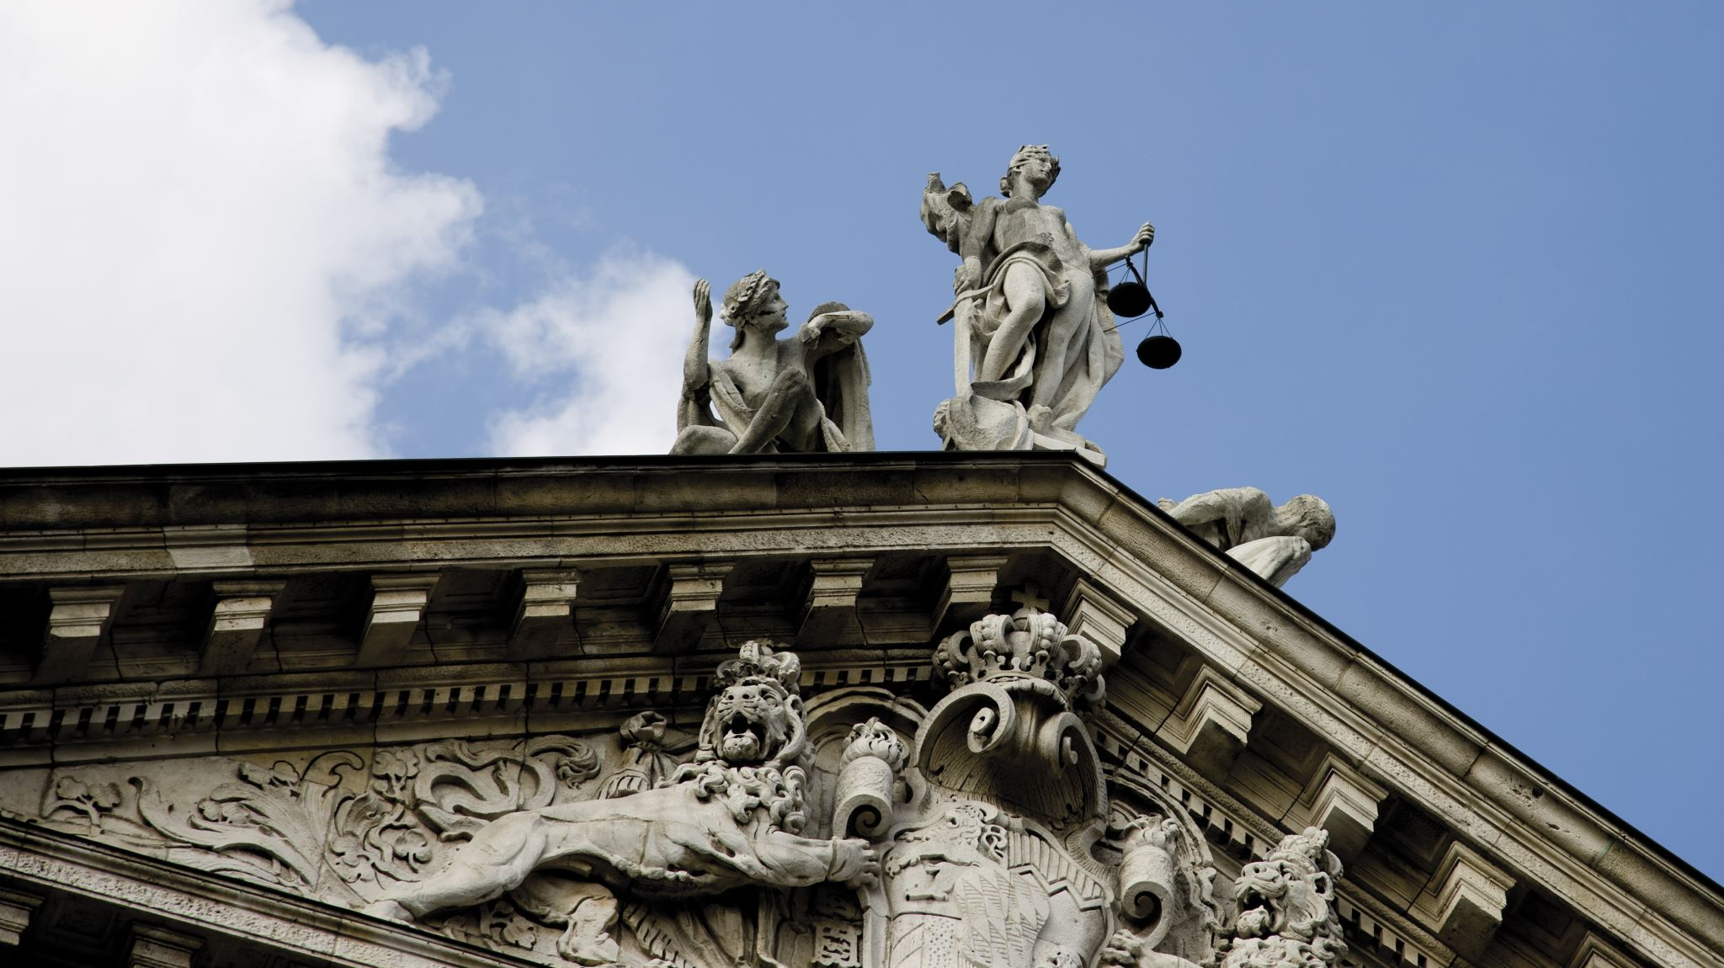
Judge Thomas Troward
By Gina Colvario Krupka
Vicky Jeter
Kamatara Johnson

Slide 2
The Man (1847-1916)
Born to British parents in India; his father was a colonel.
Studied law in England
He wrote for New Thought publication “Expressions” about his philosophy
Introduced to the Higher Thought Center of London through Alice Callo and was asked to speak
Practiced law as a judge for 25 years in India
When he retired in 1902, he devoted himself to
Scripture and comparative religions (similar to Ernest Holmes)
Studied the Koran, Hindu scriptures, books of Raja yoga, the Bible
Metaphysics
Painting
Past president of the International New Thought Alliance
2nd wife helped to publish many of his works posthumously

Slide 3
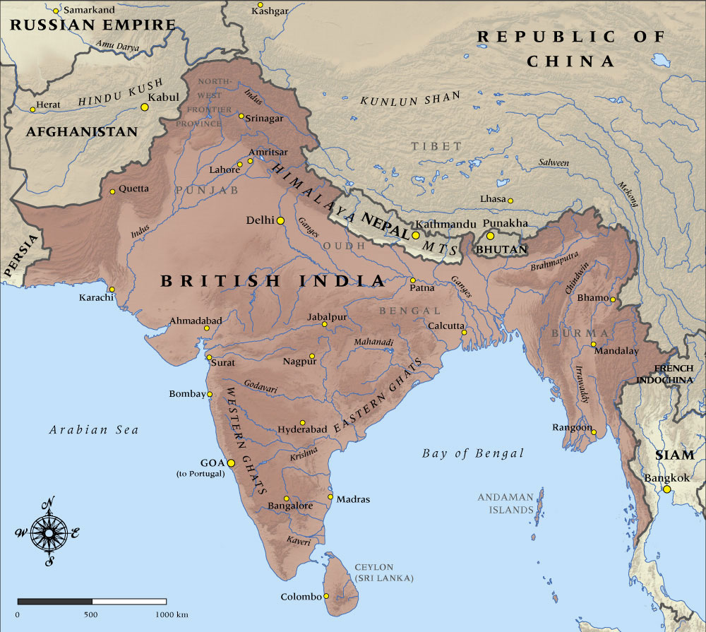
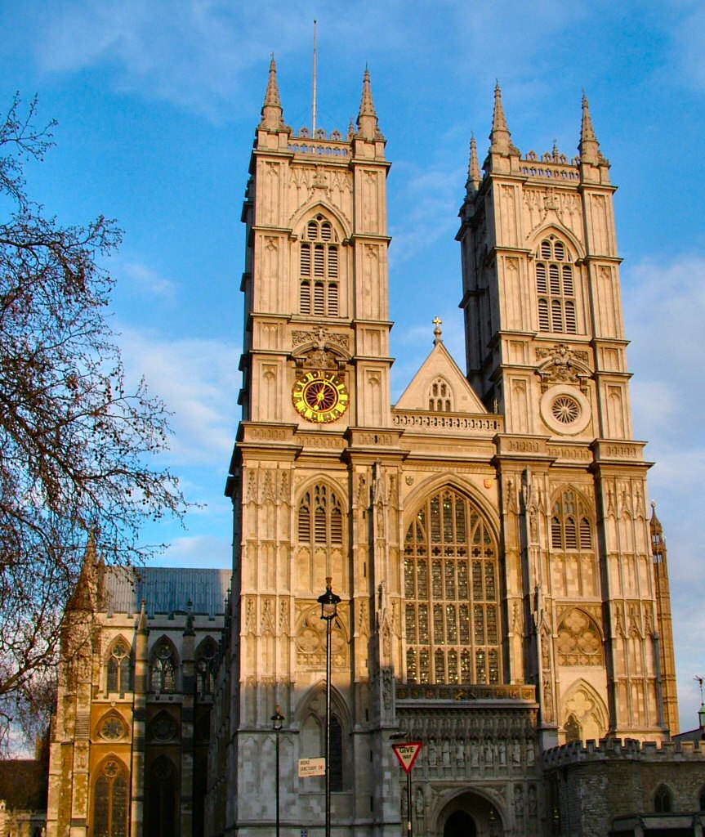
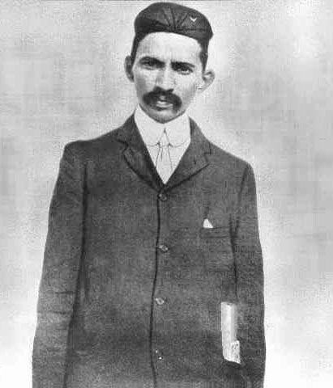
Context—culture—challenges
Gandhi as a young lawyer
West Minster Abbey
Gandhi as a young lawyer
Colonial India, England education, practicing the Law, more focused on spiritual philosophy and discovering truth as opposed to other new thought contemporaries focused on Christianity, revelation, and healing.

Slide 4
First Cause vs Individual Personality
Universal Life Principle
“Quality of Livingness” = Consciousness
Consciousness is what we do with it
Personality is God expressing as me

Slide 5
Chaos vs Order
The Universe thrives on increasing levels of order In the physical world and in our thought process.
“In the true order, everything is seen from within.”
“Order is Heaven’s first law.”

Slide 6
Defining Evil
Evil is NOT an outer force like the Devil but rather a perfectly natural outcome of the misdirected use of a man’s creative instrument of thought.

Slide 7
Inductive Vs Deductive Reasoning in the Co-Creative Process
Creative process, “My mind is a center of divine operation.” “Principle is not bound by precedent.”

Slide 8
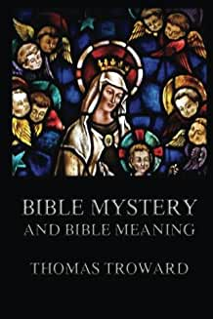
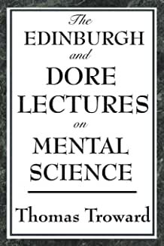
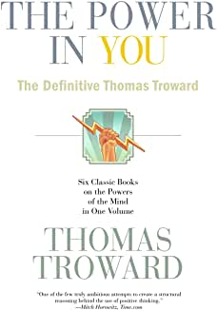
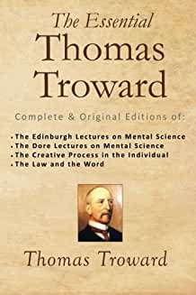
Major Works
1904
The Edinburgh Lectures on Mental Science
1909
The Dore Lectures on Mental Science
1913
Bible Mystery and Bible Meaning
1915
The Creative Process in the Individual
1915
The Years 1914 to 1923 in Bible Prophecy
1917
The Law and the Word
1921
The Hidden Power and Other Papers on Mental Science

Slide 9
Influence on Holmes
“Principle is not bound by precedent.”
“Subjective Mind vs Objective Mind.”
Order is the first Law of the Universe
Individual personality vs Universal Mind
Polarities
First Cause
deductive reasoning: affirmative prayer
Truth is to be discovered, not revealed only to certain people.
Ernest Holmes said he read every book by Troward, that it influenced about 25% of Science of Mind, but it’s hard to tease out where Troward stops and Holmes starts…

Slide 10
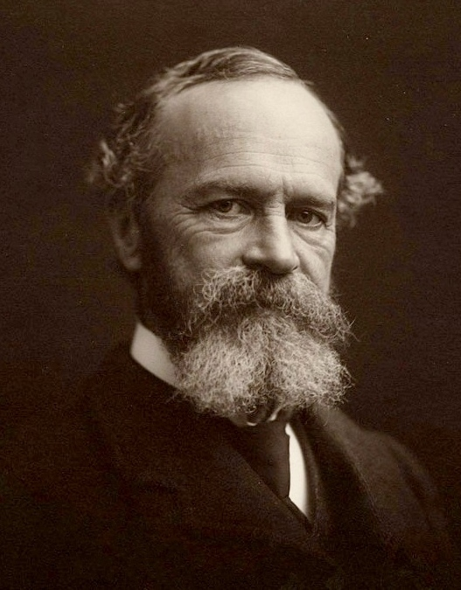
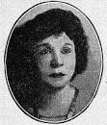
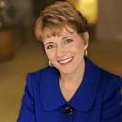
Troward Influencing others
William James
The Varieties of Religious Experience, which informed the foundation of Alcoholics Anonymous
Genevieve Behrend
Your Invisible Power
Mary Morrissey
Prosperity Plus

Slide 11
Contrasting Troward & Holmes
As Ernest Holmes evolved, his use of principal became more connected with the Love.
Ernest Holmes took Troward’s system and applied it to specific instances as seen in Science of Mind
Ernest Holmes was a charismatic speaker who synthesized complex concepts into more comprehensible language for the everyday person.
Troward said your power weakens if it is spoken. Think this and keep it to yourself. Holmes said to declare it!

Slide 12
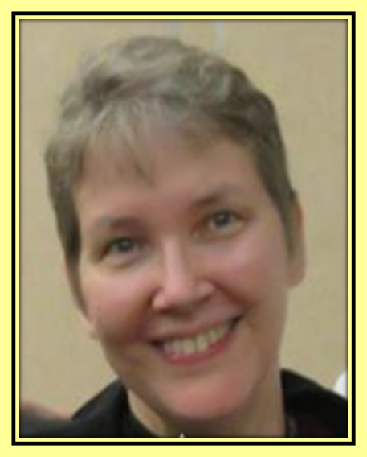
How might this inform my ministry?
The basis of Science of Mind is informed by Troward’s writings, concepts, and systems
The Law is impartial and works for everyone as we work it, whether unconsciously or consciously.
Change your thinking; change your life.
There is a Power greater than us and we can use it!
Everything begins within.
Principle is not bound by precedent = frees us from the false limitations of the past into Infinite possibility.
This is a system that works, practical mysticism, to be passed on to those whom we serve.

